Slide 1


INTERLIFE General Insurance Company S.A.
April 2025

Slide 2


Balance Sheet 2024 Selected Financial Data
Total Shareholders’ Equity
139,75 m €
Total Assets
340,26 m €
INTERLIFE ΑΣΦΑΛΙΣΤΙΚΗ [ΑΠΡ.2025]
2

Slide 3
Results 2024 Selected Financial Data
Gross Written Premiums
100,35 m €
Net Claims
69,72 m €
Insurance Service Result
-2,49 m €
Investment Result
20,3 m €
Profit after Tax 11,71 m €
Basic Earnings Per Share (EPS)
0,64 €
INTERLIFE ΑΣΦΑΛΙΣΤΙΚΗ [ΑΠΡ.2025]
3

Slide 4
Financial Data 2024 Gross Written Premiums
Gross Written Premiums Increase
2024
6,96%
INTERLIFE ΑΣΦΑΛΙΣΤΙΚΗ [ΑΠΡ.2025]
4

Slide 5
Financial Data 2024 Insurance Revenue
(Amounts expressed in €) | 31/12/2003 | 31/12/2024 | Change %
Earned Gross Premiums | 88.557.205 € | 98.982.000 € | 11,77%
INTERLIFE ΑΣΦΑΛΙΣΤΙΚΗ [ΑΠΡ.2025]
5

Slide 6
Financial Data 2024 Claims and Provisions
(Amounts expressed in €) | 31/12/2023 | 31/12/2024 | Μεταβολή %
Policyholders’ Claims | 55.874.111 | 64.348.981 | 15,17%
Change in Insurance Provisions | 7.022.608 | 5.368.149 | -23,56%
Net Policyholders’ Claims | 62.896.719 | 69.717.130 | 10,84%
INTERLIFE ΑΣΦΑΛΙΣΤΙΚΗ [ΑΠΡ.2025]
6

Slide 7
Financial Data 2024 Statement of Income under IFRS 17
Revenue (Ποσά εκφρασμένα σε €) | 31/12/2023 | 31/12/2024 | Change %
Insurance Revenue | 88.557.205 | 98.982.000 | 11,77%
Insurance Service Expenses | -85.913.280 | -95.293.612 | 10,92%
Income/Expense from Reinsurance Contracts Held | -6.161.675 | -6.178.395 | 0,27%
Insurance Service Result | -3.517.749 | -2.490.007 | -29,22%
INTERLIFE ΑΣΦΑΛΙΣΤΙΚΗ [ΑΠΡ.2025]
7

Slide 8
Financial Data 2024 P&L summary results - IFRS 17 Adjusted
(Amounts expressed in €) | 31/12/2023 | 31/12/2024
Insurance Service Result | (3.517.749) | (2.490.007)
Investment Result | 24.718.943 | 20.562.082
Insurance Finance Expenses | (751.994) | 390.602
Operating & Other Expenses | (3.154.310) | (3.690.423)
Profit before tax | 17.294.889 | 14.772.254
Income Tax | (3.586.357) | (3.034.831)
Profit after tax | 13.708.532 | 11.737.423
Actuarial Gains/Losses | -4.540 | -23.485
Total Comprehensive Income After Tax | 13.703.992 | 11.713.938
Basic Earnings Per Share | 0,7419 | 0,6353
INTERLIFE ΑΣΦΑΛΙΣΤΙΚΗ [ΑΠΡ.2025]
8

Slide 9
Financial Data 2024 Balance Sheet Items– IFRS 17 Adjusted
(Amounts expressed in €) | 31/12/2023 | 31/12/2024 | Change %
Total Assets | 306.222.302 | 340.255.713 | 11,11%
(Amounts expressed in €) | 31/12/2023 | 31/12/2024 | Change %
Other Liabilities | 14.135.019 | 17.466.056 | 23,57%
(Amounts expressed in €) | 31/12/2023 | 31/12/2024 | Change %
Insurance Contract Liabilities | 161.099.546 | 183.044.265 | 13,62%
(Amounts expressed in €) | 31/12/2023 | 31/12/2024 | Change %
Total Shareholders’ Equity | 130.987.737 | 139.745.392 | 6,69%
INTERLIFE ΑΣΦΑΛΙΣΤΙΚΗ [ΑΠΡ.2025]
9

Slide 10
Total Shareholders' Equity 2024 Development – IFRS Adjusted
INTERLIFE ΑΣΦΑΛΙΣΤΙΚΗ [ΑΠΡ.2025]
10

Slide 11
Total Assets 2024 Development – IFRS Adjusted
INTERLIFE ΑΣΦΑΛΙΣΤΙΚΗ [ΑΠΡ.2025]
11

Slide 12
Financial Data 2024 Alternative Performance Metrics
APM |  | 31/12/2023 | 31/12/2024
SCR Ratio | Eligible own funds / Solvency Capital Requirement | 184,00% | 166,57%
MCR Ratio | Eligible own funds / Minimum Capital Requirement | 660,00% | 625,52%
% Revenue Change (Premiums) | % Annual Change in Insurance Revenues | 11,45% | 11,77%
Loss Ratio | Claims Paid to Policyholders + Other Operating Expenses Attributable to Insurance Costs + Adjustments to Insurance Claims Liabilities) / Insurance Revenues | 83,19% | 82,93%
Operating Expenses Ratio | Total Operating Expenses / Insurance Revenues | 8,94% | 9,63%
Commission Ratio (Acquisition Costs) | Earned Acquisition Commissions / Insurance Revenues | 19,45% | 19,59%
Operating and Commission Expense Ratio | (Operating Expenses + Earned Acquisition Commissions) / Insurance Revenues | 28,40% | 29,23%
Combined Ratio | (Claims Paid + Change in Insurance Provisions + Operating Expenses + Earned Acquisition Commissions) / Insurance Revenues | 100,23% | 99,66%
Profitability Ratio 1 | Profit Before Tax / Insurance Revenues | 19,53% | 14,92%
Profitability Ratio 2 | Profit After Tax / Insurance Revenues | 10,47% | 8,40%
Coverage Ratio 1 | Liabilities / Own Funds | 133,78% | 143,48%
Coverage Ratio 2 | (Investment Property + Financial Assets + Cash and Cash Equivalents) / Total Assets | 93,93% | 94,61%
Coverage Ratio 3 | (Financial Assets + Cash and Cash Equivalents) / Total Assets | 84,71% | 85,48%
INTERLIFE ΑΣΦΑΛΙΣΤΙΚΗ [ΑΠΡ.2025]
12

Slide 13
Financial Data 2024 Investment Revenue
(Amounts expressed in €) | 31/12/2023 | 31/12/2024
Investment Income | 3.835.520 | 6.431.722
Gains from Sale of Financial Instruments | 1.978.773 | 6.005.777
Gains on Revaluation of Financial Assets | 17.229.515 | 7.548.558
Gains/Losses from Fair Value Measurement of Investment Properties | 1.138.028 | 314.296
Investment Result | 24.181.835 | 20.300.353
INTERLIFE ΑΣΦΑΛΙΣΤΙΚΗ [ΑΠΡ.2025]
13

Slide 14
Investments 2024 Investment Development and Structure
INTERLIFE ΑΣΦΑΛΙΣΤΙΚΗ [ΑΠΡ.2025]
14

Slide 15

Return on Equity Greek Insurance Market
Return on Equity – ROE (before tax)
INTERLIFE ROE
2023
19,53%
Source: KPMG – 2024 Annual Report KPMG
INTERLIFE ΑΣΦΑΛΙΣΤΙΚΗ [ΑΠΡ.2025]
15

Slide 16
Premium (Insurance) Production Development 2024 By Line of Business
Line of Business | 2023 | 2024 | Difference | ± %
Marine, Aviation & Transport Insurance | 2.151.572 | 2.389.797 | 238.225 | 11,07%
Medical Expense Insurance | 13.392.225 | 13.999.105 | 606.880 | 4,53%
Fire & Other Damages To Property Insurance | 3.634.335 | 3.910.594 | 276.259 | 7,60%
Motor Vehicle Liability Insurance | 47.344.153 | 50.401.245 | 3.057.092 | 6,46%
Other Motor Insurance | 14.063.728 | 16.124.290 | 2.060.562 | 14,65%
Other LoBs | 13.235.476 | 13.523.027 | 287.552 | 2,17%
Total | 93.821.488 | 100.348.059 | 6.526.571 | 6,96%
INTERLIFE ΑΣΦΑΛΙΣΤΙΚΗ [ΑΠΡ.2025]
16

Slide 17
Premium (Insurance) Production Development 2024 Motor – NonMotor
Portfolio | 2023 | 2024 | Απόκλιση 2023/2024 | ± %
Motor | 72.623.634 | 78.388.943 | 5.765.309 | 7,94%
Non-Motor | 21.197.854 | 21.959.116 | 761.262 | 3,59%
Total | 93.821.488 | 100.348.059 | 6.526.571 | 6,96%
INTERLIFE ΑΣΦΑΛΙΣΤΙΚΗ [ΑΠΡ.2025]
17

Slide 18
Comparative Premium Data: Greece vs. Europe Premiums per Capita
Insurance Branches | 2022 |  | 2023 |  | Change (%) 2022 – 2023
 | Greece | Europe | Greece | Europe | Greece | Europe
General | 195 | 1,242 | 214 | 1,321 | 10% | 6%
Vehicle | 95 | 381 | 101 | 405 | 7% | 6%
Property | 48 | 397 | 54 | 427 | 14% | 8%
Other | 53 | 464 | 58 | 489 | 11% | 5%
Source: HAIC, EIOPA
INTERLIFE ΑΣΦΑΛΙΣΤΙΚΗ [ΑΠΡ.2025]
18

Slide 19
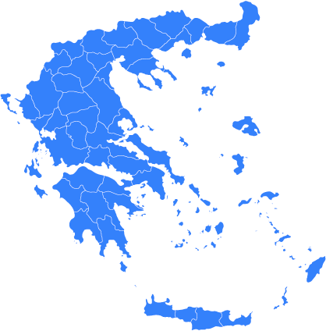
Comparative Premium Data: Greece vs. Europe GDP vs. Insurance Premiums: Annual % Change
Correlation between Insurance Premiums and GDP Insurance Penetration in Greece (%)
 | 2022 |  | 2023
 | Greece | Europe | Greece | Europe
GDP | 5,6% | 3,5% | 2,3% | 0,4%
Premiums | 4% | 1% | 9% | 4%
Greece
2023: 2,4%
2022: 2,3%
Source: ELSTAT, HAIC
Πηγή: ΕΑΕΕ, EIOPA
INTERLIFE ΑΣΦΑΛΙΣΤΙΚΗ [ΑΠΡ.2025]
19

Slide 20
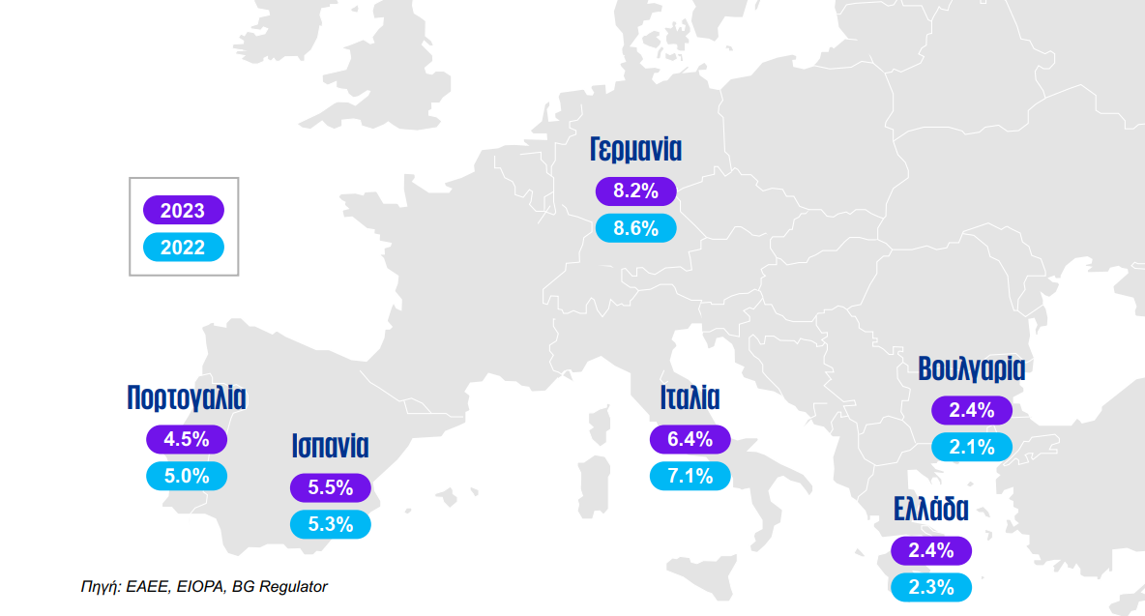
Correlation between Insurance Premiums and GDP Insurance Penetration in Europe (%)
Germany
Bulgaria
Portugal
Italy
Spain
Greece
Source: HAIC, EIOPA, BG Regulator
INTERLIFE ΑΣΦΑΛΙΣΤΙΚΗ [ΑΠΡ.2025]
20

Slide 21
Statistical Data Development in the Number of Residential Insurance Policies
Insurance Coverage
2023
17,57%
2024
18,90%
Source: HAIC
INTERLIFE ΑΣΦΑΛΙΣΤΙΚΗ [ΑΠΡ.2025]
21

Slide 22
Legislation New Measures and Incentives for Insurance Against Natural Disasters
Business Insurance Law 5162/2024, Article 25, effective from 1/6/2025
Concerning:
Businesses with Annual Gross Revenues Over €500,000€
Obligatory Risks to be Insured:
Wildfire
Flood
Earthquake
on buildings, equipment, raw materials, merchandise, commercial vehicles, production means, and stored products
Non-compliance:
Fine 10.000€
Exemption from Government Assistance
Source: HAIC
INTERLIFE ΑΣΦΑΛΙΣΤΙΚΗ [ΑΠΡ.2025]
22

Slide 23
Legislation New Measures and Incentives for Insurance Against Natural Disasters
Vehicle Insurance Law 5162/2024, Article 25, effective from 1/6/2025
Concerning:
All owners or holders of any vehicle
Obligatory Risks to be Insured:
wildfire
Flood
at the current Market Value of the vehicle, even when it is stationary without license plates.
Non-compliance:
Exemption from Government Assistance
Source: HAIC
INTERLIFE ΑΣΦΑΛΙΣΤΙΚΗ [ΑΠΡ.2025]
23

Slide 24
Legislation New Measures and Incentives for Insurance
Mental Health Facility Insurance Law 5129/2024, Article 20, effective from 1/1/2025
Concerning:
Private Legal Entities of Profit and Non-Profit Character with Mental Health Units
Their Scientific Staff
Obligatory Risks to be Insured:
Civil Liability of the Private Legal Entity Towards third parties for accidents occurring within the Facility causing Bodily Injuries, Material Damages, or Loss of Life
Professional Civil Liability of the Scientific Staff towards third parties for omissions, errors, negligence, mistakes, and accidents
Non-compliance:
Has not been disclosed
Source: HAIC
INTERLIFE ΑΣΦΑΛΙΣΤΙΚΗ [ΑΠΡ.2025]
24

Slide 25
Legislation New Measures and Incentives for Insurance
Short-term Rental Property Insurance (Airbnb) Law 5170/2025, Article 3, effective from 1/10/2025
Concerning:
Short-term Rental Property Owners (Airbnb)
Obligatory Risks to be Insured:
Liability Towards Third Parties for accidents occurring within the accommodation causing Bodily Injuries, Material Damages, or Loss of Life
Non-compliance:
Has not been disclosed
Source: HAIC
INTERLIFE ΑΣΦΑΛΙΣΤΙΚΗ [ΑΠΡ.2025]
25

Slide 26
Legislation New Measures and Incentives for Insurance
Insurance for Public Works Consulting Firms Law 5170/2025, Article 30, effective from 30/6/2025
Concerning:
Sole Proprietorships and legal entities conducting public studies or offering technical and related services
Obligatory Risks to be Insured:
Professional Civil Liability of the Consultant towards All Third Parties
Non-compliance:
Non-registration in the Registry of Public Works Consulting Firms
Source: HAIC
INTERLIFE ΑΣΦΑΛΙΣΤΙΚΗ [ΑΠΡ.2025]
26

Slide 27

ΙΝΤΕΡΛΑΪΦ (INTERLIFE) Ανώνυµη Ασφαλιστική Εταιρεία Γενικών Ασφαλίσεων
Αρ. Γ.Ε.ΜΗ: 057606004000
ΘΕΣΣΑΛΟΝΙΚΗ (ΕΔΡΑ): 14ο χλμ Ε.Ο. Θεσσαλονίκης – Πολυγύρου, ΤΚ 57001 Θέρμη, Τ: 2310 499000, F: 2310 499099
ΑΘΗΝΑ: Καλλιρρόης 65, ΤΚ 11743, Τ: 210 9334 994, F: 210 9334 693
ΡΟΔΟΣ: Γ. Παπανικολάου 20, ΤΚ 85100, Τ: 22410 31200, F: 22410 29800
ΚΡΗΤΗ: Εθν. Αντιστάσεως 152, ΤΚ 71306 Ηράκλειο, Τ: 2810 344670, F: 2810 301410
www.interlife.gr • info@interlife.gr
και στα Social Media:
ΑΠΟΠΟΙΗΣΗ ΕΥΘΥΝΗΣ:
Η παρουσίαση αυτή έχει ετοιμαστεί από την INTERLIFE Α.Α.Ε.Γ.Α. και έχει αποκλειστικά πληροφοριακό σκοπό. Οι πληροφορίες που περιέχονται προέρχονται από την Εταιρεία και άλλες εξωτερικές πηγές, οι οποίες θεωρούνται αξιόπιστες, πλην όμως δεν παρέχεται ουδεμία εγγύηση για την ακρίβεια ή την πληρότητα των στοιχείων που παρατίθενται. Οι προηγούμενες αποδόσεις δεν αποτελούν εγγύηση για τις μελλοντικές.
INTERLIFE ΑΣΦΑΛΙΣΤΙΚΗ [ΑΠΡ.2025]

